Slide 1

The
Pestalozzi-Fröbel-Haus
Working for a good start in life
Notes:
Good morning, everyone. Let‘s get started. I‘m Ludger. As you know, since April I have had a new job as the director of the PFH. This is an organization in Berlin/Germany which manages a school for socialpaedagogic studies, many kindergartens and other projects for families and their needs.
This morning I‘m going to be telling you what we are, what we do and what we want.

Slide 2

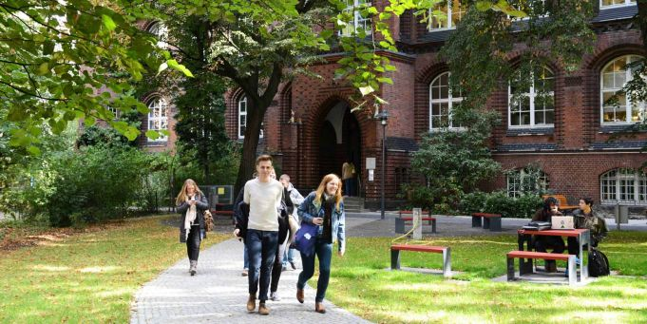
Structure
The Organization
Our History
Our main goals
Our approach
Actual initiatives
Notes:
So, I‘ll start off by giving you an overwiew of our organization
and its history.
After that I‘ll highlight what I see as the main goals
and our working approach.
I‘ll conclude my presentation with bringing you up to date with some actual initiatives and projects of our company.

Slide 3
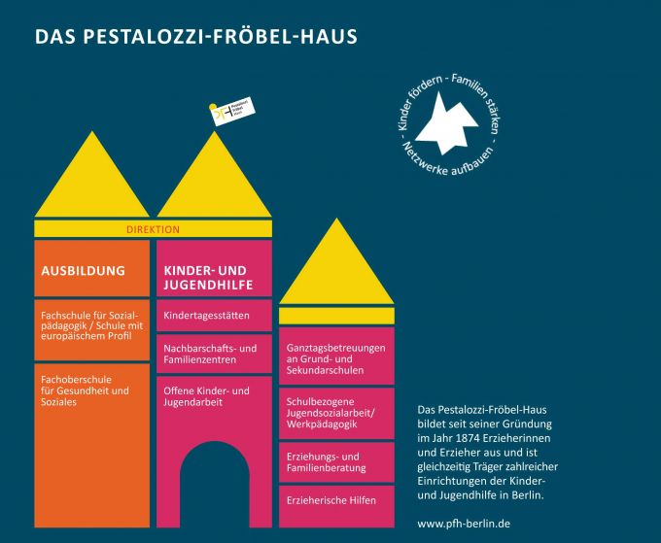
The organization
Notes:
Now, firstly some rough information about our organization. As you see on this picture, we have two main departments.
In orange color, you see the department of Education („Ausbildung“). This is the nucleus of our company. We serve a school with two different curricula, regarding to the level of the degree. In this department we have around 50 employees, most of whom are teachers.
Magenta color marked the other department for children care, youth work and family services („Kinder- und Jugendhilfe“). Originally this department was founded for the purpose of training the future educators. But after World War II and especially in the last 20 years this department has heavily increased to up to more than 500 employees. As you see, this department is much bigger.
Not on the image, but important: We have an administration. In that third department we have around 40 employees.
As the director I‘m the head and responsible for all departments.

Slide 4
The organization
a college of social education-school
an advanced technical collegue of health and social care
nine kindergartens (children centres)
full-day care provision in nine schools
six family- and neighborhoodcentres
youth social work in schools
several sites for children and youth work
two therapeutic residential groups
a family counseling
around 600 employees
Notes:
Now I‘ll give you more detailed information listing our facilities.
This is our school department with the two different curricula.
Furthermore we serve nine kindergartens in several districts of Berlin. They have different sizes between 50 up to 120 places for children.
A growning-up-offer is the full-day care provision in nine schools, seven of them settled in primary schools.
Some family- and neighborhood centres serve a wide range of opportunities for families, neighborhoods and their needs on counseling, communication and rooms for several purposes.
We offer youth social work in different ways, one hand in cooperation with the school staff, at the other hand outside of schools. A special approach for this is are therapeutic residential groups offering an accomodation for young people who want or have to leave their families. At the moment we are going on to open a third therapeutic commune.
Our family counseling is housed in two places. They are open for all families in the neighborhood and is especially engaged in supporting refugess.

Slide 5
Our history
founded 1874 by Henriette Schrader-Breymann
Based on ideas of
- Friedrich Fröbel (her aunt and teacher) and
- Johann Heinrich Pestalozzi (Fröbels teacher)
Pestalozzi (1746-1827):
Education „with head, heart and hands“
Fröbel (1782-1852):
Inventor of the term „Kindergarten“
Notes:
Now I‘ll fill you in on the background history of our organization.
The PFH is founded 144 years ago (related to 2018) by Henriette Schrader-Breymann.
She was inspired by ideas of Friedrich Fröbel and Johann Heinrich Pestalozzi.
Pestalozzi as the older one invented a holistic meaning of education. As a summary we use the term „with head, heart und hands.“ (But in a practical view he failed, as his school collapsed because of money.)
Fröbel as his pupil is the inventor of the term „Kindergarten“. He developted and set in practise an integrated concept of early childhood education, teaching his pupils how to teach children in courses and simultaneously in a practical way managing the kindergarten. Unfortunately he died in a phase while his concept of kindergarten was forbidden by the Prussian goverment. They were told/believed that the kindergarten as a socialistic experiment.

Slide 6
Our main goals
to promote child development
to strengthen families
to serve high-quality training
to manage the company as a learning organization
Notes:
On this slide I‘m outlining some important goals for our work.
We want to promote child development by looking at every child as a enthusiastic learner.
For sustainable success we think it is important to participate the familiy in this work, particulary the parents. Parents mean everyone who feel responsibility for the child.
To do that we need highly-professional child-care-educators. Therefore we offer ongoingtraing, both before and during the job.
Education needs an integrity of content and form. This is my own task and special responsibility as the director of the organization.

Slide 7
Our approach
Since 2000:
„Early Excellence Concept“:
Every child is excellent at its own.
Excellence is not a obligation for the child.
Involving the parents.
Notes:
Since 2000 we have developed and set in practise an approach named the „Early Excellence Concept“, coming from Corby/England. Here the approach was developed in the 1990th years because of the many disadvantages for children due to the increasing unemployment. The English government at that time supported this concept and founded children centres in the whole country after the example of Corby.
Excellence has an inclusive and not an exclusive meaning. It means: Every child is excellent on its own.
Excellence is not a obligation for the child but for the educator: to recognise and to strenght the skills of every children individually.
And as I said, an important method for doing this is to involve the parents. The goal is that they understand what their children need and how they can support the childs development.
All of this is founded by the „positiv view“ on the issues. For example: In fact some parents seem not very good educators for their child But we think: All parents want to do the best for their child.

Slide 8
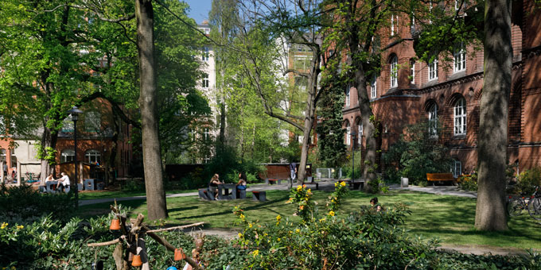
Actual initiativs
„Mellensee“
„Sozialassistenten-Ausbildung“
„Barrierefreiheit“
Notes:
Finally I would like to bring you up-to-date on some actual initiativs. In regarding to the time I choose three of them as examples:
„Mellensee“ is a lake near Berlin. Here we are developing an outdoor site beside the lake as a location for group-tours, for meetings and as a workspace for handycraft activities in cooperation with schools.
Under the term „Sozialassistenten-Ausbildung“ we are going to develop a socialpaedogogic entry training for refugees and people with a low level of certificate. This is also a result of the increasing lack of skilled employees („Fachkräftemangel“)
„Barrierefreiheit“ means: Making our campus fit for people with physical disabilities. This is a complicated and expensive task because our campus housed beautiful, but very old buildings. But we see no alternatives because we want to be an inclusive enviroment.

Slide 9

Thank you for your attention!
Tokio

